Slide 1

Placement Projects
A Digital Transformation & Integration Opportunity

Slide 2
1. ABOUT US | DTI
WHO
WHAT WE WANT
At DTI, we perform world-class custom software development services that empowers our clients to make the most of their raw data, driving innovation throughout their business by delivering secure cloud-based solutions and knowledge-based systems that can digitally transform processes, generate cost savings and support strategic decision making.
With over 25 years of combined experience in bespoke software consultancy, the team has a wide variety of expertise in cyber security, data science, image processing, computer vision and cutting edge AI techniques.
Our vision is to plug the gaps between processes and technology application by accelerating business workflows, implementing systems integrations and optimising business operations from concept to code and from development to deployment.
At DTI, we are always looking out for talented individuals who are ambitious, who love challenges, who are keen to gain industrial experience and have a passion to excel. Our talented team brings together a wide range of skills, interests and cultural backgrounds, so that we can tackle the day-to-day challenges of building incredible digital solutions.
We don’t just look for people who want a job, we look for down to earth, hard-working individuals who want to do great work as part of a team and grow their careers in a work environment that encourages them to shine and connect with others of similar mindset.
WHAT WE WILL OFFER
WHERE
Through opportunities for rapid career progression and career coaching, we create an exciting and dynamic culture that enables you to learn new skills and grow as a professional. Post placement, there will be potential job opportunities or work references to support career development.
At DTI, we believe in a healthy work-life balance so we put you in the driver seat for your projects and your work hours. Your work will be done remotely with flexible hours, and weekly or bi-weekly touch points with your team.

Slide 3
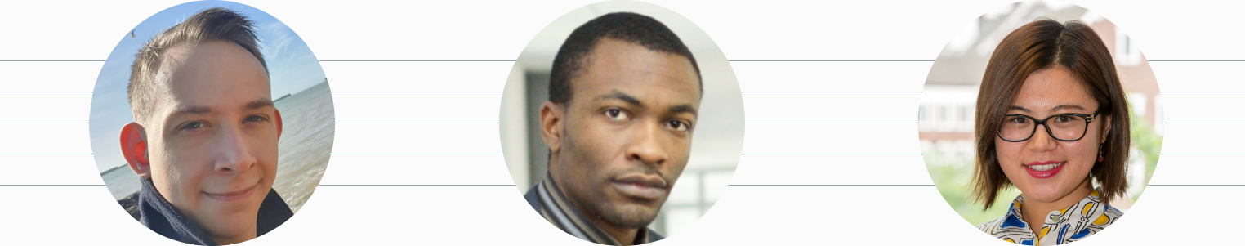
2. ABOUT US | THE TEAM
Matthew Freeman (BSc Hons)
Dr. Olatunde Banjo
Dr. Orange Gao
Matt’s passion is all things computing. Studying software engineering from the age of 12, swiftly moving into bare-metal server deployment and network facilitation with a concentration on cyber security.
Matt’s 14 years of experience facilitates full-stack software engineering; deployment of secure infrastructure at a datacenter level and comprehensive systems design techniques to efficiently tackle challenging processes.
Olatunde is a computer science researcher with a background in mechatronics engineering.
With over 8 years of industrial experience in the automotive industry including manufacturing, supply chain consulting positions at LEVC, JLR and FORD. Over the years, Olatunde has built a wealth of experience in vehicle launch, battery technology, business enterprise solutions. As a qualified six-sigma, he has led many continuous improvement projects.
Orange is a computer science researcher by education, data scientist by heart; and analytics evangelist by profession.
With over 8 years working within the data ecosystem, Orange commands and develops cutting-edge machine learning techniques to derive deeper meaning from data that others will overlook- from demographic analysis, to innovation and essential KPIs.

Slide 4
3. PROJECT 1 | SUPPLY CHAIN ANALYSIS + OPTIMISATION
Aim
To create a freight optimiser module that will be integrated into a logistics and supply chain management system.
Problem Statement
Due to poor planning, scheduling supply chain activities can result in long delay times for delivery lorries, with an average of 175 deliveries per week for some OEMs leading to up to 72% of delivery lorry time on OEM sites classified as non-value add i.e. waiting to be processed. Additionally, lack of visibility of inbound deliveries makes it difficult to process deliveries and plan the right level of resources. Environmental Impact – Emissions from HGV grown by 25-30% and without a significant change in freight policy, HGV emissions will not meet the Climate Change Bill targets.
Objectives
Design and implement an algorithm capable of optimising freight capacity, route, milk-run consolidation and cubic container density.
Design and implement interactive User Interface.
Create automated workflows that enable standardization of supply chain data input for freight optimisation.
Design and implement knowledge-base system with deep learning capabilities to respond to unforeseen scenarios e.g. supply chain disturbances
Design and implement digital dashboards to visualise supply chain data and KPIs.
Duration: 3 months (full time)
Essential Requirements: Data Analysis, UI/UX Design, software Development
Learning and Skills Development Opportunities
Industrial Experience
Coaching and Mentoring
Industrial application of Data Science techniques
Project management, leadership and customer relations

Slide 5
4. PROJECT 2 – AI-ENABLED CRM SYSTEM
Aim
To build an AI-based CRM system which takes advantage of business strategy and technology in order to bring a customer-centric plan to automate customer-facing business processes including marketing, sales and customer service
Problem Statement
Creating a relationship with new and existing customers is the key to business success. Companies with a dedicated customer relationship management (CRM) generates an increase in expansion revenue, a boost in net retention and a drop in gross churn. However, not all companies have adopted customer relationship management strategy. Depending on the different goals and needs, a general CRM cannot meet the requirements from all kinds of business. A lack of AI-based CRM system which can extract the insight and customaries the optimised CRM is the market niche.
Objectives
Study the customer-centric strategy model based on different types of business through data mining.;
Centralize all customer data within the business, combines all sales, marketing and customer service information into one central database;
Marketing CRM: to collect and store data from potential and existing customers to create smarter strategies and build better business relationships;
Sales CRM: to deliver quote, track performance and organize activities;
Support CRM: to create a knowledge base, live chat support and automated response; to create a ticketing system to manage all customer inquiries.
Duration: 3 months (full time)
Essential Requirements: Data Analysis; Communication; Prototyping
Learning and Skills Development Opportunities
Have a good understanding of ecommerce and marketing business
Have a key role in a digital transformation project
Identify new commercial opportunities
Manage project implementations and day-to-day CRM activity

Slide 6
5. PROJECT 3 – SMART PARKING SYSTEM
Aim
Our aim is to build a smart parking system towards a complete end-to-end solution, which enables parking operators to remotely and automatically monitor parking occupancy rates in real-time.
Problem Statement
In present day cities, finding an available parking spot is always difficult for drivers; and it tends to become harder with ever increasing number of private car users. This situation can be seen as an opportunity for smart cities to undertake actions in order enhance the efficiency their parking resources thus leading to reduction in searching times, traffic congestion and road accidents. Problems pertaining to parking and traffic congestion can be solved if the drivers can be informed in advance about the availability of parking spaces at and around their intended destination.
Objectives
Implement vehicle detection sensor technology, make use of sensors like Infrared, Passive Infrared (PIR) and Ultrasonic Sensors.
Build processing unit: the processing unit acts like an intermediate between the sensors and cloud. Data collected from various sensors is sent to the processor and the processor then transmit the data to the cloud server through MQTT (Message Queue Telemetry Transport) Protocol.
Build Mobile application: the mobile application acts like an interface for the end users to interact with the system, which provides information regarding availability of parking spaces and allowing the end user to book slot accordingly.
Build the Cloud: The cloud will act as a database to store all the records related to parking areas and end users that have access to the system. It keeps a track of every user connected to the system and maintains information such as time at which the car was parked, time duration for parking a car etc.
Duration: 3 months (full time)
Essential Requirements: Technology Interest, Good Comprehension of IT
Learning and Skills Development Opportunities
Complex problem-solving skills
Strong understanding of responsive front end design principles
Be skilled at development and verification using different coding languages

Slide 7
5. PROJECT 4 – BUSINESS DEVELOPMENT
The Role
This is a varied role where you will be responsible for delivering leads and managing your own work-loads, diary and appointments. The successful candidate must have the determination and ability to deliver results unsupervised, whilst maintaining the passion to engage with clients for new business opportunities. As part of the business development team, you will be in charge of managing a list of clients, generating new revenues and analysing the markets.
The Benefits
DTI offers exciting opportunities to learn and develop the vital skills that are needed in the world of business development. As part of a small team, you will have the opportunity to support business growth for an SME.
The Person
Able to set and work towards long-term goals
Experience of winning new business and building relationships
Entrepreneurial mindset with a pro-active attitude
Natural networking ability - able to confidently approach others and build rapport with ease
Drive and ambition to learn, develop and progress
Demonstrate consideration for your career and how that will help your growth
Key Duties
Researching organisations and individuals to find new opportunities.
Promote digital presence through social networks e.g LinkedIn, twitter
Develop product lines and client base
Benchmark competitors for product lines and DTI services
Perform market research and identify emerging technology trends
Plan and overlook marketing communication and campaigns

Slide 8
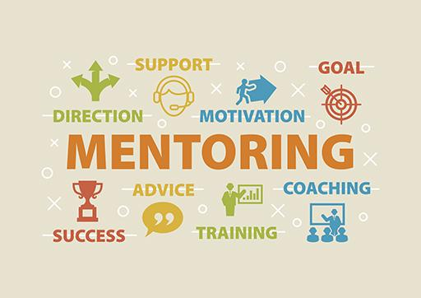

6. YOUR DEVELOPMENT – MENTORING, COLLABORATION
MENTORING & FLEXIBILITY
DTI promotes flexible working hours and an opportunity to plan your workload to create a healthy work-life balance. The team consists of industrial PhD graduates who are able to provide mentoring and support to for your PhD and overall career development from practical experience.
EXPOSURE
All projects will give students the opportunity to work within a collaborative organisation and to experience first hand the direct application of data science techniques to real life industrial problems. On some projects, students will be able to work closely with some of our industrial partners in other sectors.

